Slide 1


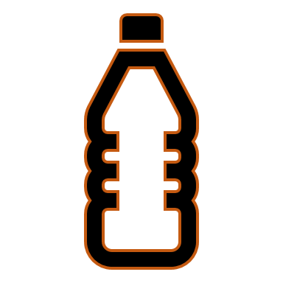
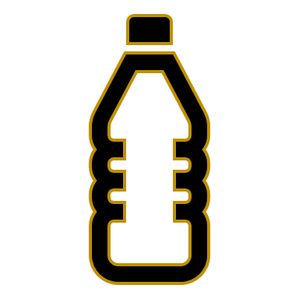



Cartesian Diver
What you need:
A clear 500ml plastic bottle and cap
A tomato ketchup sachet
Water
The Science
This experiment is all about density. The ketchup sachet floats because an air bubble is trapped inside it when it was sealed at the factory. When you squeeze the bottle the air bubble in the sachet compresses (gets smaller) as the water pushes into it, making it denser than the water around it, and the sachet sinks.
Stop squeezing and the bubble gets bigger again and the sachet rises. If it does not work try a different sachet, soy sauce sometimes works well.
What you do:
Remove labels from your bottle so that you can watch the action.
Fill the bottle to the very top with water.
Place the sealed tomato ketchup sachet inside the bottle. (Remember don’t open the sachet)
Screw on the bottle cap nice and tight.
Now for the fun part. Squeeze the bottle hard – what happened? Stop squeezing.
Can you get the sachet to stop in the middle?

