Slide 1

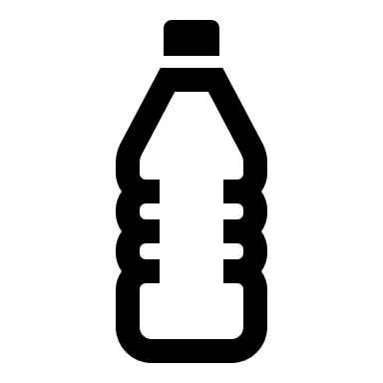






Inflating Glove
V
I
nega
r
What you need:
Plastic cup (no handle)
Latex glove
Bicarbonate of soda
Vinegar
Spoon
Sellotape or elastic band
3x
Bicarb
w
The Science
A chemical reaction is when two or more substances interact and change to make a new substance. Combining bicarbonate of soda and vinegar creates a new one. This change involves a solid (bicarbonate of soda) and a liquid (vinegar) which when combined creates a gas (carbon dioxide). Trapping the carbon dioxide gas with the latex glove causes the glove to inflate. The carbon dioxide can escape from very small holes in the latex causing the glove to flop over.
What you do:
Fill the cup about 1/8th full of vinegar.
Put three heaped teaspoons of bicarbonate of soda into the glove’s fingers.
Carefully pull the glove’s body over the top of the cup. Secure in place with Sellotape or elastic band.
Pull the fingers of the glove up over the cup so that the bicarbonate of soda falls into the vinegar, allow it to mix causing a chemical reaction.
Watch and listen.

